Slide 1
From Here to There: Video inbetweening using direct 3d convolutions
December 5, 2020
Ritij Saini Milind Niranjan Kunal Chhabra
17D070027 170050047 19D070031

Slide 2
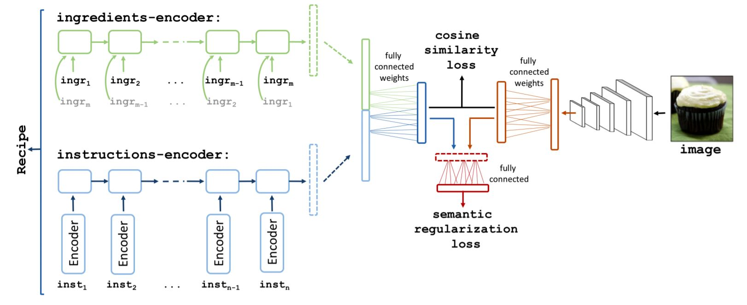
Previous Problem Statement:
To develop a ‘image to recipe’ generator to output recipes for any given input image of a food item. The Recipe1M+ dataset contained 1M recipes with 13M associated images
Link to this paper
http://pic2recipe.csail.mit.edu/tpami19.pdf

Slide 3
Why wasn’t it Viable??
Recipe1M is a subset of Recipe1M+ dataset with a size of 200 GB on which we were planning to train, and since the output recipes have to be too detailed, there was no other alternative rather than training on this subset, which would take a significant amount of time & resources.
Another issue was importing the dataset into a Virtual Machine of Google Cloud Platform with Nvidia Tesla v100 GPU using wget command, which wasn’t viable clearly due to th per hour cost already exceeded $5. So despite various attempts & resource constraints, we had to drop this project.

Slide 4
Current Problem Statement:
Using Deep Learning Techniques to generate moving videos from still images, by realistic interpolation of the initial and final image, considering the challenge of memory limitations due to huge pixel sizes of the images.
Our approach was based on the following two papers, mainly on [1];
[1] Haoye Cai, Chunyan Bai, Yu-Wing Tai, and Chi-Keung Tang. Deep video generation, prediction and completion of human action sequences. In Proceedings of the European Conference on Computer Vision (ECCV)
[2] Yunpeng Li, Dominik Roblek, and Marco Tagliasacchi. From here to there: Video inbetweening using direct 3d convolutions. arXiv preprint arXiv:1905.10240, 2019

Slide 5
Introduction
Major challenge nowadays is that the space of output videos is exceptionally large, despite short and low-resolution videos
E.g. A 30 frame RGB Video of 64X64 pixels consumes 368640 spaces
We have used 3-Dimensional CNNs to keep trainable parameters manageable while maintaining high dimensionality

Slide 6
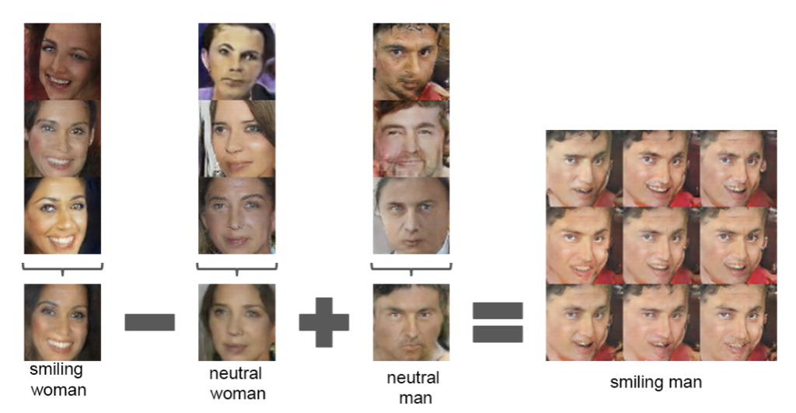
Recent Approaches to the Problem
A new architecture is used where the initial and final images are encoded in a latent space, a sequence of actions is generated and finally translated into the output video.
Can be implemented either by a CNN or an RNN.
https://machinelearningmastery.com/how-to-interpolate-and-perform-vector-arithmetic-with-faces-using-a-generative-adversarial-network/

Slide 7
Our Implementation to the Problem
We planned to implement CGAN with encoding and decoding in Latent Space and adopted a fully convolutional approach.
However, we found a “simple” approach- i.e. rather than working with any handcrafted features, such as a separation of foreground and background features or a handcrafted latent space designed to capture the relevant degrees of freedom in the image, we worked directly at the level of pixels with CGAN & CVAE

Slide 8
Description of DataSet:
We used the Moments in Time Dataset for both training and testing.
It consists of 1,000,000 videos divided into 339 categories.
Neural Network is trained in such a manner that videos are generated from a single category at a time to make video completion more achievable.
Categories on which we have worked on - Skiing and erupting
Skiing- 1800 Training Videos and 81 Test Videos.
Erupting- 2000 Training Videos and 100 Test Videos
Note: We have downsized all videos from 90 frames 256X256 pixels to 30 frames videos with 64X64 pixels in each frame, and pixel values rescaled to lie between 0 to 1 to reduce computational time.

Slide 9
Baseline Model: Interpolation with ffmpeg
The first simple model which came to our mind was implementing some simple interpolator/ffmpeg functions for initial and final image.
Failed completely as only 2 frames aren’t enough for generating a complete video.
https://www.hellocatfood.com/misusing-ffmpegs-motion-interpolation-options/

Slide 10
Method I: Conditional Variational Autoencoder (CVAE)
A directed graphical generative model which has obtained excellent results and is among the state of the art approaches to generative modeling. Like any other autoencoder architecture, it has an encoder and a decoder
The encoder part tries to learn hidden representation of data X or encoding the X into the hidden representation and the decoder part tries to decode the hidden representation to input space
Difference between general VAE and CVAE: VAE cannot generate specific data because the encoder models the latent variable to be independent of type of data while the decoder data to be directly based on the latent variable. We could improve VAE by conditioning the encoder and decoder to another variable- Concept of CVAE

Slide 11
Continued...
A Variational autoencoder encodes the video as gaussian distribution and a KL Divergence term is added to loss function to make the encoded gaussian distribution close to unit normal distribution.
This method is called CVAE here as the encoder and decoder are conditioned on initial and final images which are additional data in this case.
Video Encoder- 3 Dimensional CNN followed 2 FC layers.
Video Decoder- Random noise input,with initial and final frames,encoded inCNN.
Inputs were concatenated followed by FC Layer and 3D CNN layers to generate output video.

Slide 12
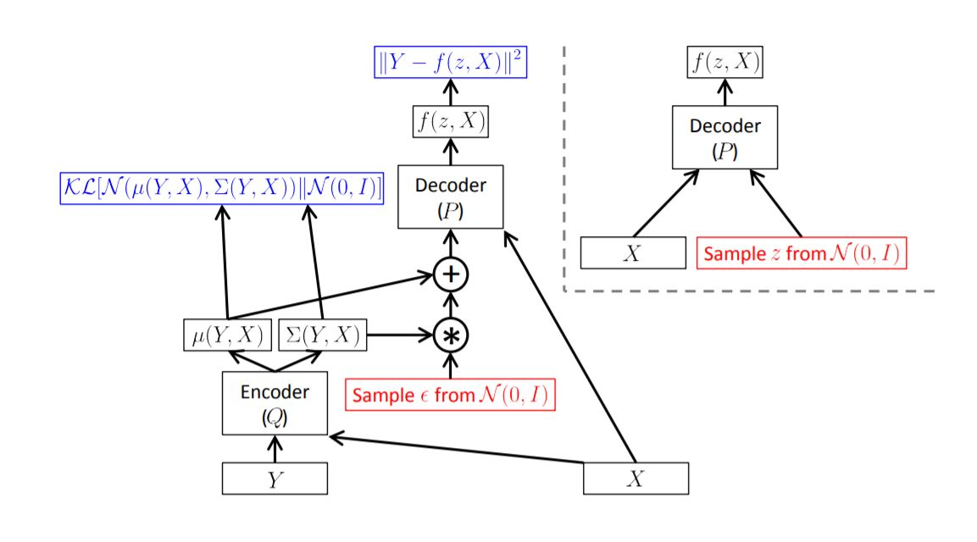
Continued...
Left: A training-time conditional variational autoencoder implemented as a feedforward neural network
Right: The same model at test time, when we want to sample from P(Y|X).
https://arxiv.org/pdf/1606.05908.pdf

Slide 13
Continued...
Training Objective Function-
Where X is the training video (with initial and final frames x_{i} and x_{f}), μ and Σ are the mean and covariance matrix for the latent space distribution conditioned on input video, G is the generated video (with initial and final frames G_{i} and G_{f} ), and λ₁ and λ₂ are hyperparameters.

Slide 14
CVAE Architecture
Video Encoder:
Image Encoder
Input: | Video X, 30 x X₀ x W₀ x {1,3}
L1: | Conv3D(X, C=64, K=(3,4,4), S=(1,2,2))
L2: | Conv3D(L1, C=128, K=(3,4,4), S=(1,2,2))
L3: | Conv3D(L2, C=256, K=(3,4,4), S=(1,2,2))
L4: | Conv3D(L3, C=512, K=(3,4,4), S=(1,2,2))
L5: | Concat([Flatten(L4), E_{I}(x_{i}), E_{I}(x_{f})])
L6: | Linear(L5, C=1024)
L7: | Linear(L6, 2 encoding dimension = 2 600)
Output: | Vectors μ(X), 𝜎(X) = L7, softplus applied for 𝜎(X)
Input: | Image x, H₀ x W₀ x {1, 3}
L1: | Conv2D(x, C=16, K=4, S=2)
L2: | Conv2D(L1, C=32, K=3, S=1)
L3: | Conv2D(L2, C=64, K=4, S=2)
L4: | Conv2D(L3, C=128, K=3, S=1)
L5: | Linear(Flatten(L4), C = 256)
L6: | Linear(L5, C = image encoding dimension = 1000)
Output: | Feature map E_{I}(x) = L6

Slide 15
Continued...
Video Generator:
Input: | Video latent representation z, encoded image vectors E_{I}(x_{i}), E_{I}(x_{f})
L1: | Concat([z, E_{I}(x_{i}), E_{I}(x_{f})])
L2: | Flatten(Linear(L1, C = 256 x 5 x H₀/8 x W₀/8))
L3: | TransposedConv3D(L2, C=128, K=(1,2,2), S=(1,1,1))
L4: | TransposedConv3D(L3, C=64, K=(3,2,2), S=(3,2,2))
L5: | TransposedConv3D(L4, C=32, K=(3,2,2), S=(1,2,2))
L6: | TransposedConv3D(L5, C=16, K=(3,4,4), S=(1,2,2))
L7: | Sigmoid(TransposedConv3D(L6, C=3, K=(2,4,4), S=(2,1,1)))
Output: | Video G(z) = L7, 30 x H₀ x W₀ x {1,3}

Slide 16
Main Method II: Conditional Generative Adversarial Networks (CGAN)
General GAN and its Limitations
GANs, are an architecture for training generative models, such as deep convolutional neural networks for generating images.
Although GAN models are capable of generating new random plausible examples for a given dataset, there is no way to control the types of images that are generated other than trying to figure out the complex relationship between the latent space input to the generator and the generated images.
CGAN is a type of GAN that involves the conditional generation of images by a generator model. Image generation can be conditional on a class label, if available, allowing the targeted generated of images of a given type.

Slide 17
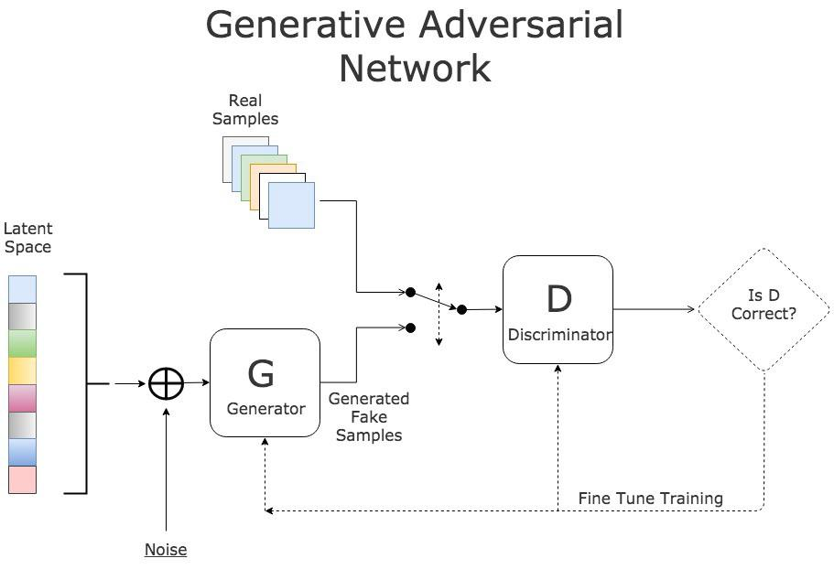
Main Method II: Continued...
https://paperswithcode.com/method/gan#

Slide 18
Main Method II: Continued...
Minimax Adversarial game between Discriminator(D) and Generator(G)
G was conditioned on initial and final image pre-processed by image encoder output video generated(Similar to CGAN)
However, unlike CGAN, D didn’t have initial and final images, and tries to discriminate between real and generated videos without any knowledge.
So, loss function terms are added for the generator G which are proportional to the L₂ squared distance between original and generated frames.
The discriminator had the same architecture as the CVAE video encoder, except with the encoded images removed from the fully connected layer, and the output Gaussian distribution replaced by a single output logit.

Slide 19
Main Method II: Continued...
The generator G used the same image encoder and video generator as in CVAE, except that we removed the last 2D convolution layer, and also for simplicity we reduced the number of channels in some of the layers.
Leaky ReLUs rather than ReLUs used For the convolutional layers in G.
Problems which we faced:
Instability during training as during training, D’s performance got so good and G never managed to improve significantly.
Memory overflow due to 260M parameters.
After every 20 epochs, our training algorithms saved those checkpoints that accounts for about 3GB of storage, so it would not be feasible to train it for more than 300 epochs.

Slide 20

Main Method II: Continued...
OBJECTIVE FUNCTION:
Where w_{G} and w_{D} are weights for G and D, X is the training video(with initial and final frames x_{i} and x_{f}), z is a latent “code” sampled froma Gaussian distribution with zero mean and unit variance, G is the generated video (with initial and final frames G_{i} and G_{f} ), and λ is a hyperparameter.

Slide 21
Results
We calculated the L2 distance between the generated and real videos, averaged over 100 test videos for “Erupting”, 81 test videos for “Skiing”. The L2 distances were calculated with pixel values rescaled to lie between 0 and 1. The numbers in this table have been divided by 100.
L2 Distance | Interpolation | CVAE | CGAN
Erupting | 50 ± 48 | 187 ± 109 | N/A
Skiing | 150 ± 91 | 190 ± 50 | N/A

Slide 22
Results: Continued...
We trained our CVAE model on 2000 “erupting” videos, we chose hyperparameters λ1 = λ2 = 2.0 in the CVAE Objective Function:
We performed mini-batch gradient descent with 20 videos per batch, using Adam optimizer with β1 = 0.8 and learning rate 0.0001. The total loss function converged reasonably well in 100 epochs.
The more advanced CVAE Model as described before was trained on 1800 “skiing” videos and the performance of this model was considerably better than the original CVAE.

Slide 23
Results: Continued...
Since CGAN training takes thousands of epochs for the generator to make meaningful improvements, we used only 300 epochs for training due to computational time constraints, and Nash equilibrium couldn’t be achieved.
The CVAEs trained on “erupting” and “skiing” achieved some plausible success and hence we have shown results only for CVAE.
Also, the testing set performance for CGANs was very poor, due to time and GPU resource limits, thus we need a large number of epochs for GAN to train, which couldn’t be done due to both computational & time constraints.

Slide 24
Original
Interpolation
CVAE
SKIING

Slide 25
Original
Original
Interpolation
OR
CVAE
CVAE
ERUPTING

Slide 26
Conclusions & Future Work
In CVAE method, we were able to produce output videos approximately based on the initial and final images. However, at least by the metric of L2 distance, our CVAE outperformed by a simple baseline of a linear interpolation between the initial and final frame.
Performance could be considerably improved by further tuning of hyperparameters which was left again due to time constraints.
Note: The CVAE version used on the skiing videos was only run on one set of hyperparameters for the “skiing” videos and was not tested at all on the “erupting” video.

Slide 27
Future Work: Continued...
With more computational power, we would be able to train our GAN model on a much larger training dataset and for many more epochs.
We used only CNNs to generate videos, which meant that the final video length was always fixed. It might be interesting to explore incorporating a RNN to be more flexible about video length and be better at unveiling the temporal correlations

Slide 28
Individual Contribution & Code
Ritiz Saini (17D070027) | Worked on overall model training and generating video output
Milind Niranjan (170050047) | Preprocessing the code,debugging and presentation
Kunal Chhabra (17D070031) | Analysing the final project,debugging and presentation
Link for Final code, Video presentation and models: https://drive.google.com/drive/folders/12oZZio-odV6XDrmniDv2jIsoaFDY01dp?usp=sharing
Note: All of our code is based on a github repository of tensorflow generative model: https://github.com/hwalsuklee/tensorflow-generative-model-collections/

Slide 29
Given the recent rapid development in this field, there are a lot more remaining to be explored

Slide 30
Thank You

Slide 31
References
[1] Haoye Cai, Chunyan Bai, Yu-Wing Tai, and Chi-Keung Tang. Deep video generation, prediction and completion of human action sequences. In Proceedings of the European Conference on Computer Vision (ECCV), pages 366–382, 2018.
[2] Carl Vondrick, Hamed Pirsiavash, and Antonio Torralba. Generating videos with scene dynamics. In Advances In Neural Information Processing Systems, pages 613–621, 2016.
[3] Jacob Walker, Carl Doersch, Abhinav Gupta, and Martial Hebert. An uncertain future: Forecasting from static images using variational autoencoders. In European Conference on Computer Vision, pages 835–851. Springer, 2016.
[4] Yunpeng Li, Dominik Roblek, and Marco Tagliasacchi. From here to there: Video inbetweening using direct 3d convolutions. arXiv preprint arXiv:1905.10240, 2019.

Slide 32
References
[5] Tim Salimans, Ian Goodfellow, Wojciech Zaremba, Vicki Cheung, Alec Radford, and Xi Chen. Improved techniques for training gans. In Advances in neural information processing systems, pages 2234–2242, 2016
[6] How to Explore the GAN Latent Space When Generating Faces
[7] Understanding Conditional Variational Autoencoders
[8] Tensorflow generative model collections. https://github.com/hwalsuklee/tensorflow-generative-model-collections/

